Slide 1


Team 7
E-COMMERCE SENTIMENT ANALYSIS:
LEVERAGING CUSTOMER REVIEWS FOR BRAND INSIGHTS
Sibora Boba, Selma Doganata, Kalelo Dukuray, Rafid Rahman, Ramim Tarafdar

Slide 2






MEET THE TEAM
SIBORA
BOBA
SELMA DOGANATA
KALELO DUKURAY
RAFID RAHMAN
RAMIM TARAFDAR
Notes:
We could use this slide to introduce everyone's role in the project

Slide 3


TODAY'S AGENDA
1
Introduction
2
Methodology
3
Data Collection + Processing
4
Data Model
5
Business Intelligence + Insights
6
Tech Stack + Roles
7
Conclusion

Slide 4

Industry Context
Platforms like Amazon collect massive amounts of customer reviews, which have a direct impact on purchasing decisions and brand reputation. These reviews serve as valuable, yet underutilized, resources for understanding consumer perspectives.
Problem Statement
Despite the availability of customer feedback, brands lack efficient tools to classify and analyze this data at scale. Without clear insights, it’s challenging to spot recurring issues or strengths that impact customer satisfaction and influence buying behavior.
PROBLEM STATEMENT
Objective
Enable brands to gain valuable insights into customer sentiment, helping them understand consumer perceptions and identify actionable areas for product or brand enhancement.

Slide 5
Data Collection
Amazon API or BeautifulSoup for data pulls; store in SQLite or PostgreSQL based on dataset size
Data Storage
Data will be stored using a scalable database setup, leveraging SQLAlchemy with SQLite for small datasets and PostgreSQL for larger, cloud-hosted datasets.
METHOD
+
PROCESS
Data Cleaning
Clean the data, removing duplicates, normalizing text, and filtering out irrelevant content with pandas, NumPy, and Python NLP tools for standardized text.
Sentiment Analysis
Use Scikit-learn for sentiment classification; TensorFlow or Hugging Face for advanced modeling.
Data Visualization
Tableau for BI dashboards, visualizing actionable sentiment insights.

Slide 6
DATA COLLECTION
API ACCESS
DATA WRANGLING
SUPPLEMENTARY DATA
STORAGE
We initiated data collection through GET requests to the Amazon Product Advertising API, retrieving product reviews, ratings, and timestamps.
Used pandas to clean and structure raw API data, handling duplicates, missing values, and standardizing formats.
Data was stored in SQLite for testing or PostgreSQL for scalable storage in production.
For additional data fields or extended coverage, we employed BeautifulSoup to scrape reviews directly from Amazon’s product pages.

Slide 7
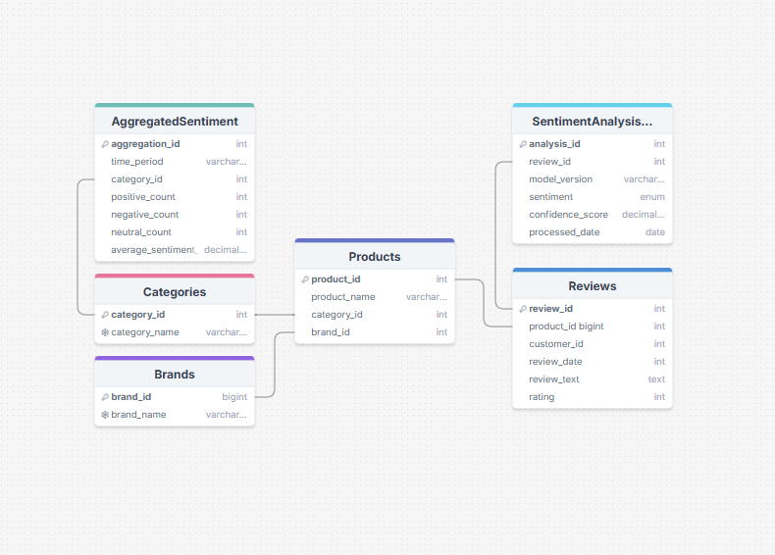
DATA MODEL

Slide 8

BUSINESS INTELLIGENCE DASHBOARD
DATA SOURCE
METRICS
[ Sentiment Trends ]
Track positive, neutral, and negative sentiments over time.
[ Product Comparison ]
Visualize sentiment distribution across different products or categories.
[ Top Keywords ]
Display frequently used positive and negative keywords in customer reviews.
Pull sentiment and review data from Amazon API and web scraping.
VISUALIZATION TOOLS
Use Tableau for dynamic, interactive charts and reports.

Slide 9
APPLICATION STACK
FRONTEND
BACKEND
[ Dashboard ]
Tableau for interactive visuals
[ Interactivity ]
Filter views by sentiment, product, or date.
[ Data Processing ]
Python with pandas and NumPy
[ API ]
FastAPI for data endpoints to serve dashboards.
[Sentiment Analysis ]
Scikit-learn for basic NLP; TensorFlow or Hugging Face for custom models.
DATABASE
[ Storage ]
PostgreSQL for scalable storage; SQLite for smaller data.
[ ORM ]
SQLAlchemy for seamless database management.
NLP MODELS
Sentiment analysis libraries using TensorFlow and Hugging Face Transformers

Slide 10
TEAM ROLES
SIBORA
BOBA
SELMA DOGANATA
KALELO DUKURAY
RAFID RAHMAN
RAMIM TARAFDAR
Front End (BI)
Backend + Testing Development
Data Collection + Data Base
Front End, Organization
Role Here:
Notes:
We could use this slide to introduce everyone's role in the project

Slide 11
CONCLUSION
ACTIONABLE INSIGHTS
Our analysis will provide clear sentiment trends, highlighting customer preferences, pain points, and areas for product or brand improvement.
NEXT STEPS
Scalability: Expand the model to analyze reviews across multiple platforms.
Real-Time Monitoring: Implement real-time sentiment tracking for ongoing insights.
Enhanced NLP: Refine sentiment analysis with custom NLP models for deeper insights.
IMPACT
By leveraging customer feedback, brands can enhance product quality, boost customer satisfaction, and strengthen brand loyalty.

Slide 12
THANK YOU
for your time and attention
Presented by TEAM 7

